Slide 1
SCATTER PLOT VISULIZATION USING R
PRESENTED BY – HERDILIA SUNU(26589)
GUIDED BY – PROF.DR. SVETLANA MEISSNER

Slide 2

OVERVIEW
A scatter plot pairs up values of two quantitative variables in a data set and display them as geometric points inside a Cartesian diagram.
The basic syntax to create a scatter plot in R is :-
plot(x, y, main, xlab, ylab, xlim, ylim, axes)
“Fatality from terrorism in European country from 1986 to 2014” is the example taken to illustrate and visualize the data using r.

Slide 3
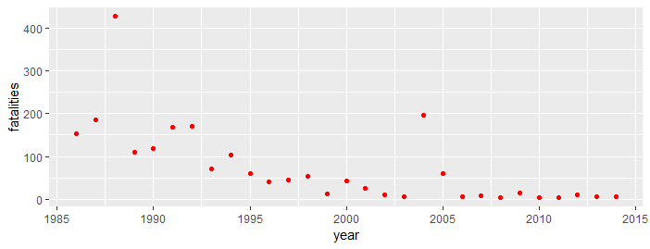
SCATTER PLOT VISUALIZATION USING R
For data visualization in r, libraries and functions like ggplot2,mplot,mosaic,
manipulate etc. are used.
ggplot2 library and its functions are used in this example.
Syntax used is -ggplot(data=df,aes(x=x_var,
y=y_var,)) + geom_point()

Slide 4
APPENDIX
# Install package
# ggplot2:for ggplot() functions.
install.packages("ggplot2")
#Use library command after installation to load the package
library(ggplot2)
library(lattice)
# Clean up :clear any previous data that can affect the result while running the code.
rm(list = ls())
#Use the basic syntax
ggplot(data = df, aes(x = x_var, y = y_var)) +geom_point()
#df is the 'data used',x_var is the varaible used in x axis,y_var is the variable used in y axis,geom_point() is the to tell ggplot that we want to draw point geoms (i.e., points).
#Use the function here.
#To change the color of the points in our ggplot scatterplot to a solid color, we need to use the color parameter.
ggplot(data = eu_terrorism_fatalities_by_year, aes(x = year, y = fatalities)) + geom_point(color = 'red')

Slide 5
REFERENCES
Tarr G, Mueller S and Welsh AH (2018). mplot: An R Package for Graphical Model Stability and Variable Selection Procedures. Journal of Statistical Software, 83(9), pp. 1-28. doi: 10.18637/jss.v083.i09
https://www.sharpsightlabs.com/blog/scatter-plot-in-r/
Data for visualization is taken from https://github.com/fivethirtyeight/data

Slide 6
THANK YOU
The code and results can be accessed from github link :
https://github.com/herdiliasunu/System-Simulation.git

